Slide 1
Reproduction in algae
Prepared by : Prof. Dr. Ahmed M. Athbi
University of Basrah
College of Education for Pure Science
Department of Biology

Slide 2
REPRODUCTION
Asexual Reproduction spores
Sexual Reproduction Gamets
Vegetative Reproduction

Slide 3
Vegetative reproduction
There are four methods of Vegetative reproduction:
- Binary fission.
- Fragmentation.
- Hormogonia.
- Propagules.

Slide 4
Asexual reproduction
-There are three types of spores:
1- Planospores (zoospores)
2- Aplanospores
- Hypenospores
- Statospores
-Autospores
-Endospores
-Exospores
3- Resting spoers
-Akinetes

Slide 6
Sexual reproduction
There are three methods of sexual reproduction:
- Isogamy
-Anisogamy
-Oogamy

Slide 7
Life cycles
There are three types of life cycles in algae:
1- Haplont
2-Diplont
3-Diplohaplont
- Isomorphic alternation of generation.
- Heteromorphic alternation of generation.

Slide 8
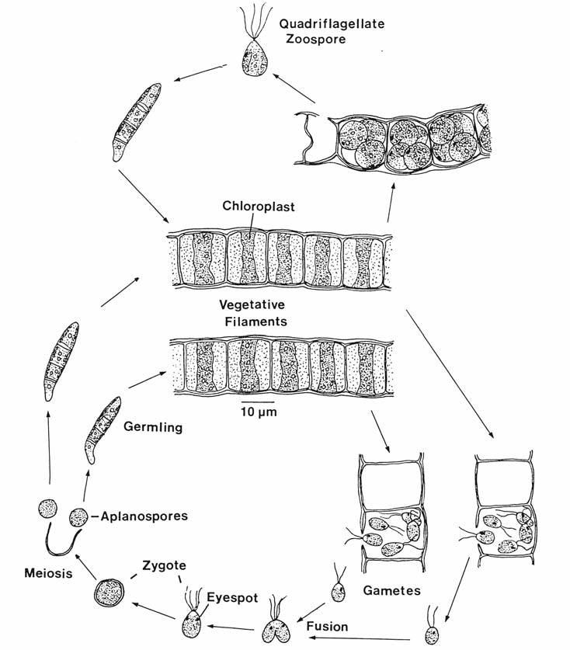

Slide 9
Reproduction in Multicellular Algae
Oedogonium reproduction
Antheridium-release flagellated sperm that swim to the oogonium
Oogonium-houses the zygote which is a diploid spore
The spore undergoes meiosis and produces 4 haploid zoospores. One of the four cells becomes a rootlike holdfast the others divide and become a new filament.
oogonium

Slide 10
Spirogyra reproduce sexually by conjugation

Slide 11
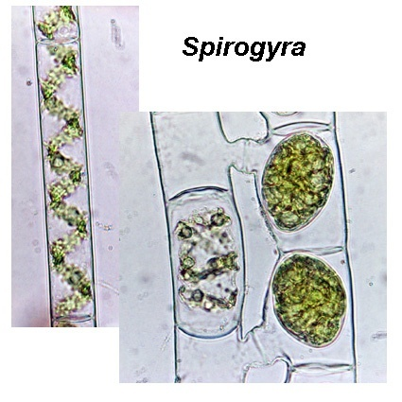
Conjugation – Sexual Reproduction

